Slide 1

Board Overview

Slide 2
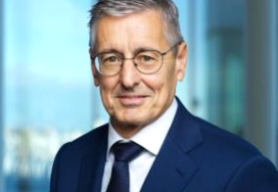
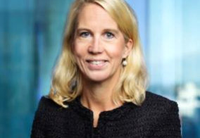
Board of Directors
Ronnie Leten (first elected 2018)
Helena Stjernholm (first elected 2016)
Chair of the Board of Directors
Deputy Chair of the Board of Directors
Chair of the Board of Directors, Chair of the Finance Committee, Member of the Remuneration Committee Born 1956. Master of Science in Applied Economics, University of Hasselt, Belgium. Nationality: Belgium Board Chair: Epiroc AB and Piab. Board Member: AB SKF.
Principal work experience and other information:
President and CEO of Atlas Copco AB 2009–2017 and various leadership positions within the Atlas Copco Group 1997–2009 and 1985–1995. Previous positions include plant manager of Tenneco Automotive Inc, Belgium, 1995–1997 and various positions within General Biscuits 1979–1985.
Deputy Chair of the Board of Directors, Member of the Finance Committee Born 1970. Master of Business Administration, Stockholm School of Economics, Sweden. Nationality: Sweden Board Member: AB Industrivärden, AB Volvo and Sandvik AB.
Principal work experience and other information:
President and CEO of AB Industrivärden since 2015. Partner in the private equity firm IK Investment Partners (2008-2015), with responsibility for the Stockholm office from 2011 to 2015. Investment Manager at IK Investment Partners (1998-2008). Previous experience as consultant for Bain & Company (1997-1998).

Slide 3
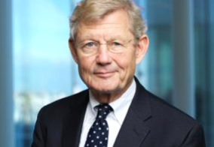
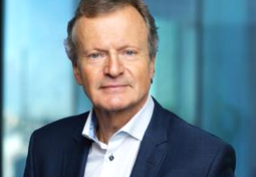
Board of Directors
Jacob Wallenberg (first elected 2011)
Jon Fredrik Baksaas (first elected 2017)
Deputy Chair of the Board of Directors
Chair of the Remuneration Committee
Deputy Chair of the Board of Directors, Member of the Finance Committee Born 1956. Bachelor of Science in Economics and Master of Business Administration, Wharton School, University of Pennsylvania, USA. Officer of the Reserve, Swedish Navy. Nationality: Sweden Board Chair: Investor AB. Deputy Board Chair: ABB Ltd., FAM and Patricia Industries. Board Member: The Knut & Alice Wallenberg Foundation and Nasdaq
Principal work experience and other information:
Chair of the Board of Investor AB since 2005. President and CEO of SEB in 1997 and Chair of SEB’s Board of Directors 1998–2005. Executive Vice President and CFO of Investor AB 1990–1993. Honorary Chair of IBLAC (Mayor of Shanghai’s International Business Leaders Advisory Council) and member of the steering committee of the European Round Table of Industrialists, Deputy Chair of the Swedish-American Chamber of Commerce US, member of the International Advisory Board of the Atlantic Council, Washington DC, member of the International Business Council of the World Economic Forum, Trilateral Commission and the Advisory Board of Tsinghua University.
Chair of the Remuneration Committee Born 1954. Master of Science in Economics, NHH Norwegian School of Economics & Business Administration, Norway. Nationality: Norway Board Chair: Statnett SA and DNV GL Group AS. Board Member: Svenska Handelsbanken AB. Holdings in Ericsson: 32,370 synthetic shares3.
Principal work experience and other information:
President and CEO of Telenor (2002-2015). Previous positions within the Telenor Group since 1989, including deputy CEO, CFO and CEO of TBK AS. Previous positions include CFO of Aker AS, finance director of Stolt Nielsen Seaway AS and controller at Det Norske Veritas, Norway and Japan. Member of the GSMA Board (2008-2016) and Chair of the GSMA Board (2014-2016).

Slide 4
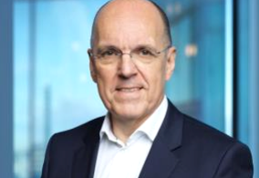
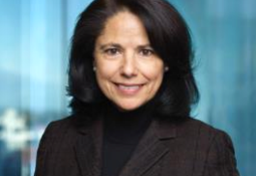
Board of Directors
Jan Carlson (first elected 2017)
Nora Denzel (first elected 2013)
Member of the Audit and Compliance Committee and the Technology and Science Committee
Member of the Technology and Science Committee
Member of the Audit and Compliance Committee and the Technology and Science Committee Born 1960. Master of Science degree in Engineering Physics and Electrical Engineering, the University of Linköping, Sweden. Nationality: Sweden Board Chair: Autoliv Inc. and Veoneer Inc.
Principal work experience and other information:
Chair and President and CEO of Veoneer Inc. since June 2018. President and CEO of Autoliv Inc. 2007-2018 and Chair of Autoliv Inc. since 2014. Previous positions within the Autoliv Group since 1999, including President Autoliv Europe, Vice President Engineering of Autoliv and President Autoliv Electronics. Previous positions include President of Saab Combitech and of Swedish Gate Array.
Member of the Technology and Science Committee Born 1962. Master of Business Administration, Santa Clara University, USA. Bachelor of Science in Computer Science, State University of New York, USA. Nationality: USA Board Member: Advanced Micro Devices, Inc., NortonLifeLock Inc. and Talend SA.
Principal work experience and other information:
CEO (interim) of Outerwall Inc. (January 2015–August 2015). Senior Vice President Big Data, Marketing and Social Product Design and General Manager QuickBooks Payroll Division (2008–2012). Previous positions include Senior Vice President and General Manager of HP’s Global Software, Storage and Consulting Divisions (2000–2006), Senior Vice President Product Operations Legato Systems (bought by DellEMC) and various engineering, marketing and executive positions at IBM. Non-Profit board member of the National Association of Corporate Directors (NACD) Northern California Chapter. Member of the Advisory Board of SUSE Linux.

Slide 5
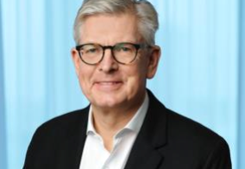
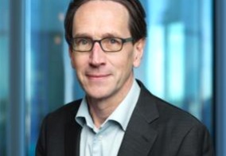
Board of Directors
Börje Ekholm (first elected 2006)
Eric A. Elzvik (first elected 2017)
President, CEO and Member of the Board
Chair of the Audit and Compliance Committee
President, CEO and Member of the Board Born 1963. Master of Science in Electrical Engineering, KTH Royal Institute of Technology, Stockholm, Sweden. Master of Business Administration, INSEAD, France. Nationality: Sweden and USA Board Member: Alibaba Group and Trimble Inc.
Principal work experience and other information:
President and CEO of Telefonaktiebolaget LM Ericsson since 2017. CEO of Patricia Industries, a division within Investor AB (2015–2017). President and CEO of Investor AB (2005–2015). Formerly Head of Investor Growth Capital Inc. and New Investments. Previous positions at Novare Kapital AB and McKinsey & Co Inc. Holds honorary Doctorate at KTH Royal Institute of Technology, Sweden. Since 2017, member of the Steering Committee of the World Economic Forum Digital Communication Governors. Member of the Board of the Swedish-American Chamber of Commerce New York.
Chair of the Audit and Compliance Committee Born 1960. Master of Business Administration, Stockholm School of Economics, Sweden. Nationality: Sweden and Switzerland Board Chair: Global Connect Group. Board Member: Landis+Gyr Group AG, AB Volvo and VFS Global.
Principal work experience and other information:
CFO and member of the Group Executive Committee of ABB Ltd (2013–2017). Division CFO ABB Discrete Automation & Motion (2010–2012) and division CFO Automation Products Division (2006–2010). Previous positions within the ABB Group since 1984, including senior management positions within finance, mergers & acquisitions and new ventures. Currently, senior industrial advisor to EQT.

Slide 6
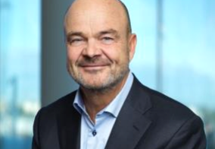
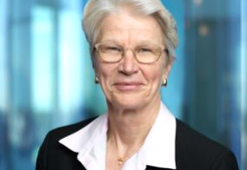
Board of Directors
Kurt Jofs
Kristin S. Rinne (first elected 2016)
Member of the Audit and Compliance Committee, the Remuneration Committee and the Technology and Science Committee
Chair of the Technology and Science Committee
Member of the Audit and Compliance Committee, the Remuneration Committee and the Technology and Science Committee Born 1958. Master of Science in Engineering, KTH Royal Institute of Technology, Stockholm, Sweden. Nationality: Sweden Board Chair: Höganäs AB and Vesper Group. Board Member: AB Volvo, Feal AB and Silver Resorts AB.
Principal work experience and other information:
Entrepreneur and investor with extensive experience in various industries. Previous positions include Executive Vice President and responsible for Ericsson’s Networks business 2003–2008, CEO of Segerström & Svensson 1999–2001, CEO of Linjebuss 1996–1999, and various positions within ABB and Ericsson.
Chair of the Technology and Science Committee Born 1954. Bachelor of Arts, Washburn University, USA. Nationality: USA Board Member: Synchronoss.
Principal work experience and other information:
Previously Senior Vice President, Network Technology, Network Architecture & Planning, at AT&T (2007–2014). CTO of Cingular Wireless (2005–2007) and VP Technology & New Product Development of Cingular Wireless (2000–2005). Previous positions within Southwestern Bell and SBC (1976–2000). Trustee of Washburn University Foundation. Member of the Advisory Board of Link Labs.

Slide 7
Nominating Committee Bios

Slide 8
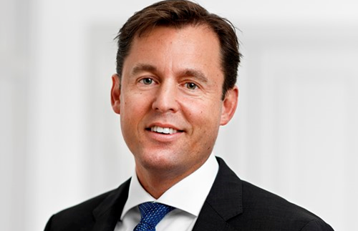
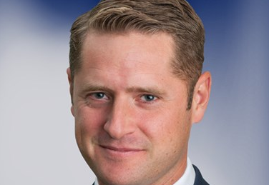
Nominating Committee
Johan Forssell
Karl Åberg
Chair of the Nomination Committee
AB Industrivärden and Svenska Handelsbankens Pensionsstiftelse
Principal work experience and other information:
Work experience
Director: Saab
Project Director: Aleris
Head of Core Investments: Investor
Head of Research: Investor
Head of Capital Goods and Healthcare sector: Investor
Head of Capital Goods: Investor
Analyst, Core Holdings: Investor
Current assignments
Director: Atlas Copco, Confederation of Swedish Enterprise, Epiroc, EQT AB, Patricia Industries, Stockholm School of Economics, The Royal Swedish Academy of Engineering Sciences (IVA), Wärtsilä,
Principal work experience and other information:
From 2013 to 2017 Karl Åberg was a partner and company investment manager in Zeres Capital, a long-term active owner in mid cap listed companies. 2009-2013 he was a partner at CapMan and from 2002 to 2008 he served within Handelsbanken Capital Markets.

Slide 9
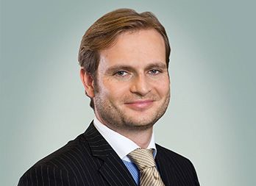
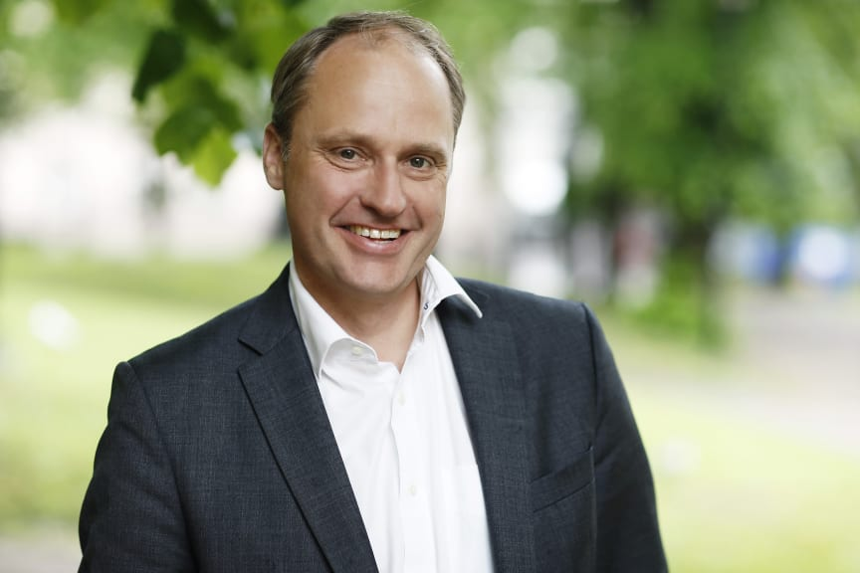
Nominating Committee
Jonas Synnergren
Anders Oscarsson
Cevian Capital Partners Limited
AMF-Försäkring och Fonder
Principal work experience and other information:
Member of the Board of Directors Veoneer Inc
Member of the Nomination Committee LM Ericsson AB
Partner Cevian Capital Ab
Head Cevian Capital's Swedish office
Principal work experience and other information:
December 2013
AMF
Aktiechef
Maj 2011 – november 2013
AMF Fonder
VD
Maj 2009 – april 2011
AMF
Aktiechef
Januari 2007 –april 2009
Aktiechef & VD för SEB Investment Management

Slide 10
Nominating Committee
Ronnie Leten (first elected 2018)
Chair of the Board of Directors
Chair of the Board of Directors, Chair of the Finance Committee, Member of the Remuneration Committee Born 1956. Master of Science in Applied Economics, University of Hasselt, Belgium. Nationality: Belgium Board Chair: Epiroc AB and Piab. Board Member: AB SKF.
Principal work experience and other information:
President and CEO of Atlas Copco AB 2009–2017 and various leadership positions within the Atlas Copco Group 1997–2009 and 1985–1995. Previous positions include plant manager of Tenneco Automotive Inc, Belgium, 1995–1997 and various positions within General Biscuits 1979–1985.

Slide 11
Executive Bios

Slide 12
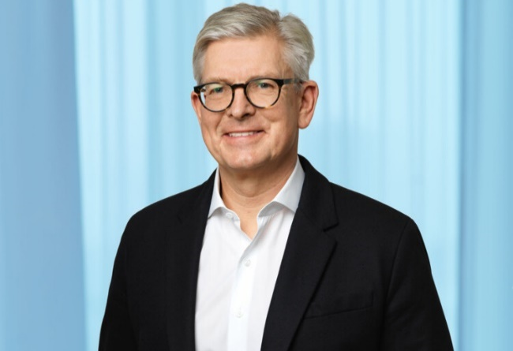
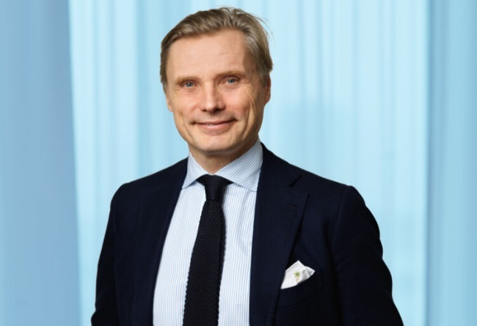
Executive Leadership
Börje Ekholm
Fredrik Jejdling
President and Chief Executive Officer
Executive Vice President and Head, Networks
Börje Ekholm is President and CEO of the Ericsson Group. He assumed this role on January 16, 2017. He knows the company and the industry well after being a Board member of Ericsson for nearly 10 years (first elected 2006).
Most recently Ekholm was CEO of Patricia Industries, a division within Investor AB (2015-January 15, 2017). Prior to assuming this position in 2015, he was President and CEO of Investor AB between 2005 and 2015. Previous positions also include Head of New Investments and President of Investor Growth Capital Inc. Ekholm has had various positions at Novare Kapital AB and McKinsey & Co Inc.
Börje Ekholm holds a Master of Science in Electrical Engineering from KTH Royal Institute of Technology, Stockholm, Sweden, as well as a Master of Business Administration, from INSEAD, France.
He is a board member of Telefonaktiebolaget LM Ericsson, Alibaba Group and Trimble. Ekholm is also Member of the Board of Trustees of Choate Rosemary Hall and the Swedish-American Chamber of Commerce New York. Since 2017, Member of the Stering Committee of the World Economic Forum Digital Communication Governors. Holds Honorary Doctorate at The Royal Institute of Technology, Sweden.
Fredrik Jejdling is Executive Vice President and Head of Business Area Networks at Ericsson since November 7, 2017. He runs the company’s largest business area with full P&L responsibility and brings to this role years of experience with customers in diverse markets. He also oversees the global production and progress of Ericsson’s radio and transport products and services across all mobile technology generations. Additionally, he supervises 5G commercialization across Ericsson. Apart from running a global unit with 30,000 employees, Jejdling manages Ericsson’s global sourcing with 20,000 suppliers.
Jejdling was previously Head of Business Unit Network Services. From 2013 to 2016 he headed Region sub-Saharan Africa, and from 2011 to 2013 he was Head of Region India. He also held various positions within Business Unit Global Services, including Head of Sales and Finance in 2008.
Before joining Ericsson in 2006, Jejdling held senior positions at Tele2 Group and Electrolux Group in Asia Pacific.
Jejdling has an M.Sc. in Economics and Business Administration from Stockholm School of Economics and received Lieutenant/Reserve Officer training from the Royal Swedish Naval Academy. He enjoys all types of sports but particularly kite and windsurfing.

Slide 13
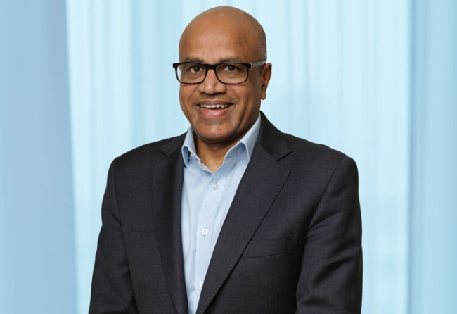
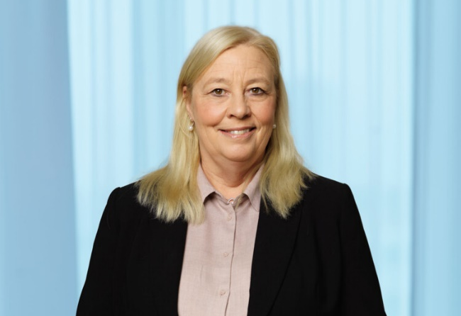
Executive Leadership (continued)
Arun Bansal
MajBritt Arfert
Executive Vice President and Head, Europe & Latin America
Senior Vice President, Chief People Officer and Head, People
Arun Bansal is Executive Vice President and Head of Market Area Europe and Latin America, the largest market area spanning over 110 countries.
As head of Europe and Latin America, Bansal is responsible for implementing Ericsson’s strategic direction and bringing a leading portfolio to customers with simplicity and speed.
Over his 25 years at Ericsson, Bansal has served as Senior Vice President of Business Unit Radio, overseeing all sales of products and solutions as well as R&D of the largest business area in the company. His leadership has resulted in all Ericsson Radio since 2015 being 5G ready, setting the foundation for Ericsson's 5G leadership. Bansal has also held various leadership positions in Southeast Asia & Oceania and India, where he was instrumental in expanding Ericsson’s operations in the region and established the world’s first Managed Capacity operation with the operator Bharti in India.
Arun Bansal holds an Engineering Degree in Electronics and Telecommunications from Madhav Institute of Technology and Science, India and a Post Graduate diploma in International Marketing from Indira Gandhi National Open University, India.
MajBritt Arfert is Chief People Officer for Ericsson, a position she has held since April 1, 2017.
Arfert started working for Ericsson right after completing her education and has extensive experience across the business in the area of Human Resources. She has held various global Executive Human Resources roles (2006-2017) such as Head of Human Resources for Ericsson Swedish Operations, Business Unit Support Solutions, Business Unit Broadband Networks and Business Unit Access which included experience in major global acquisitions and driving change.
Before that she was Head of Human Resources JV Sony Ericsson (2002-2004) in Germany with the primary focus in aligning all people related topics and handling employee & industrial relations.
In MajBritt Arfert’s role in Human Resources she has focused on making Ericsson an exceptional place for employees to work, and ensure that the company is creating a culture that attracts and inspires the most passionate talent.
MajBritt holds a B.Sc Human Resources and has also studied Finance at the University of Gothenburg, Sweden.

Slide 14
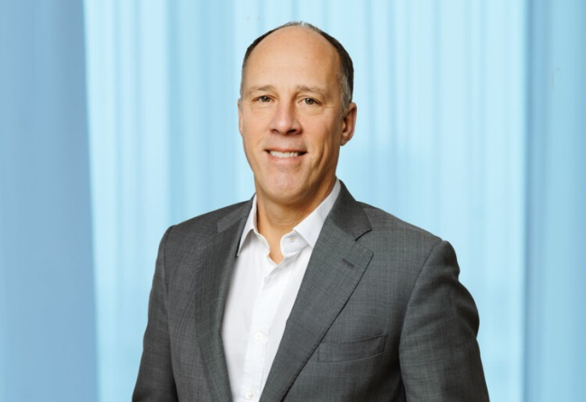
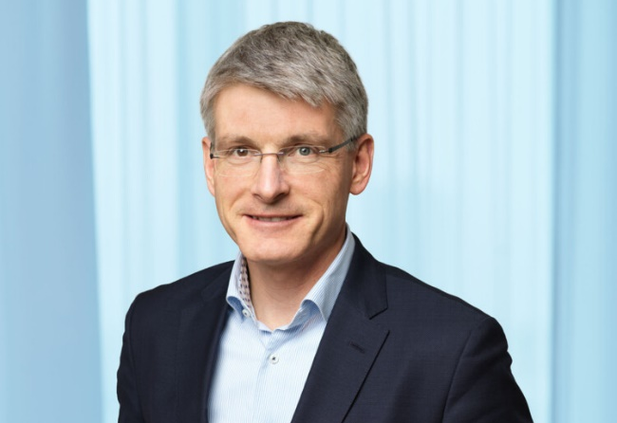
Executive Leadership (continued)
Xavier Dedullen
Erik Ekudden
Senior Vice President, Chief Legal Officer, Head of Group Function Legal Affairs & Compliance and secretary of the Board of Directors of Telefonaktiebolaget LM Ericsson
Senior Vice President, Chief Technology Officer and Head, Group Function Technology
Xavier Dedullen, Chief Legal Officer and member of Ericsson’s Executive Team, is responsible for Ericsson’s Group Function Legal Affairs & Compliance.
He joined Ericsson April 1, 2018. In addion to his duties Dedullen is Secretary to the Board of Directors for Telefonaktiebolaget LM Ericsson.
Dedullen joined Ericsson from LafargeHolcim, where he was Group General Counsel with responsibility for the Legal and Compliance functions. He had assumed this position at Holcim Ltd in 2013 and continued in this role following the merger with Lafarge SA in July 2015.
Dedullen started his career in 1988 in private practice in New York, USA. He held various legal in-house positions of increasing seniority at the European Bank for Reconstruction and Development in the UK, at PSEG Global in the UK, and at Carrier1 International in Switzerland.
Born in 1964, Xavier Dedullen is a Belgian national. He holds a Master of Laws (Lic. Jur.) from KU Leuven, Belgium, and an LL.M. from New York University School of Law.
As Group CTO, Erik Ekudden is responsible for setting the direction of technology leadership for the Ericsson Group. In 2017 he was re-located to Kista, Sweden, after nearly seven-year at Ericsson in Santa Clara, California.
His experience from working with technology leadership globally will influence the strategic decisions and investments in mobility, distributed cloud, artificial intelligence and Internet of Things. This builds on his decades-long career in technology strategies and industry activities.
Ekudden first joined Ericsson in 1993 working on mobile systems research. He has served as research area director and vice president of standardization. During his career, his team created technology and multimedia functionality that are now used in today’s smartphones worldwide. This team also conducted some of the first work on virtual and augmented reality for mobile systems. He has worked to create global mobile systems for 3G, 4G and 5G in close collaboration with customers.
He holds a Master of Science degree in Electrical Engineering from the Royal Institute of Technology in Stockholm, Sweden. Ekudden is since 2020, member of the Broadband Commission for Sustainable Development.

Slide 15
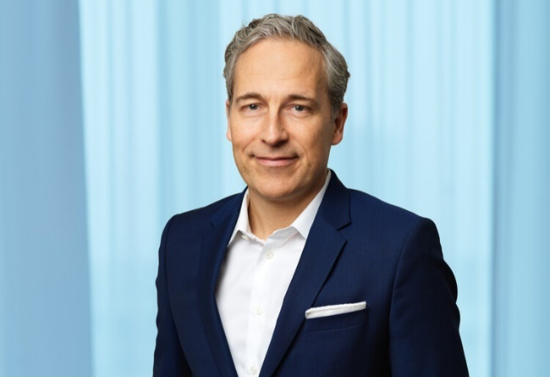
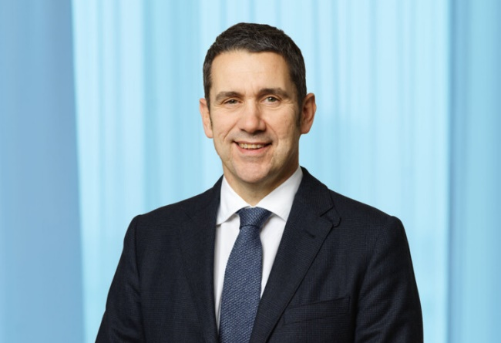
Executive Leadership (continued)
Niklas Heuveldop
Chris Houghton
Senior Vice President and Head, North America
Senior Vice President and Head, North East Asia
Niklas Heuveldop leads the Market Area North America, a organization of approximately 11,500 employees in serving Ericsson’s customers in the United States and Canada with industry-leading technology and services.
Prior to this position Heuveldop was Chief Strategy Officer, Head of Technology & Emerging Business, which combines the Corporate Strategy and Technology functions, Ericsson Research, Business Innovation, Mergers & Acquisitions and Emerging Business, focused on the Internet of Things, as well as Information Technology and Ericsson’s Digital Transformation.
Heuveldop has also had the position as Chief Customer Officer and Head of Group Function Sales. He first started at Ericsson in 1993 and has served in various international assignments across the Americas and Europe, including as Head of Global Customer Unit AT&T and Head of Market Unit Central America & Caribbean.
From 2001 to 2005, Heuveldop led venture capital-backed technology start-ups, first as COO at WaterCove Networks, which was acquired by Alcatel in 2003, and then as CEO at ServiceFactory, a management buyout from Swedish operator Telia.
Heuveldop holds a Master of Science in Industrial Engineering & Management from the Institute of Technology, Linköping University, Sweden.
Chris Houghton joined Ericsson in 1988. He has broad international experience, having held management positions with Ericsson in China, India, Japan, the UK, Ireland, Hungary and Sweden.
Previously Houghton was Head of Region North East Asia (2015 – March 2017). He served as Head of Region India from 2013 to 2015, and was Head of Customer Unit UK & Ireland from 2010 to 2013. Prior to this, Houghton served as Head of Ericsson Hungary in 2009 and 2010, overseeing Ericsson’s R&D center in Budapest. From 2004 to 2009, Houghton was Head of Ericsson’s SoftBank business division in Japan. Between 1995 and 2004, Houghton held several senior positions at Ericsson in Sweden, including Business Director WCDMA, where he was responsible for implementing commercial strategy and driving global WCDMA sales.
Houghton holds a Bachelor of Law from Huddersfield Polytechnic, England.

Slide 16
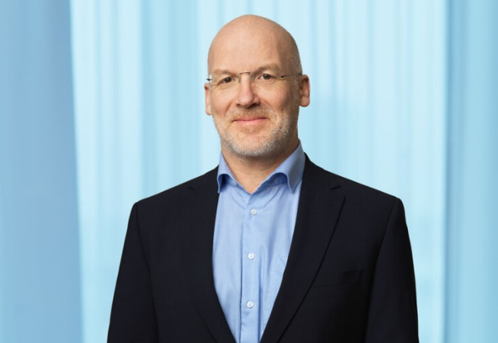
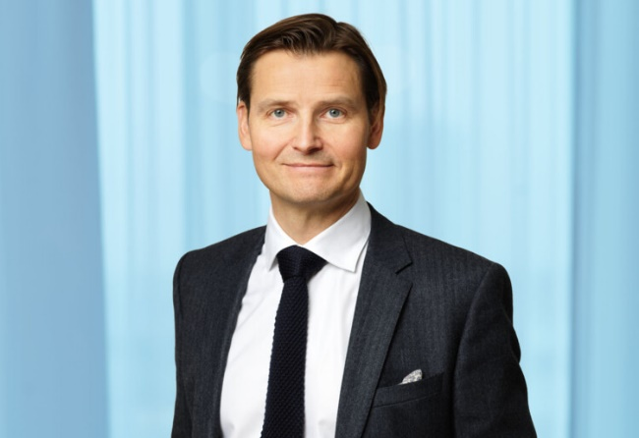
Executive Leadership (continued)
Jan Karlsson
Peter Laurin
Senior Vice President and Head, Digital Services
Senior Vice President and Head, Managed Services
Jan Karlsson is Senior Vice President and Head of Business Area Digital Services (since August 1, 2018). Ericsson Digital Services provides solutions that realize our customers’ digital transformation including software and services in the areas of monetization and management systems (OSS/BSS), telecom core (packet core and communication services), and cloud & NFV (Network Functions Virtualization) infrastructure.
Before taking on his current role, Karlsson was Acting Head of Business Area Digital Services between February 1 - July 31 2018. Previous he was Head of Solution Area Business Support Solutions at Ericsson. He also led the sales and delivery of multiple Full Stack OSS/BSS projects for Ericsson in Latin America which were among of the first of their kind to go live in the region.
Before joining Ericsson in February 2017, Karlsson was CEO of DigitalRoute, an independent software vendor focusing on data collection and pre-processing across telco and non-telco verticals.
Karlsson holds a bachelor’s degree in Business Administration from ESSEC Business School in France.
Peter Laurin is Senior Vice President and Head of Business Area Managed Services, one of Ericsson’s four business areas, since April 1, 2017. Business Area Managed Services designs, optimizes and manages networks for operators around the world. In addition, the business area manages operators’ IT applications and data centers. Ericsson provides managed services in more than 100 countries supporting approximately 1 billion subscribers.
Before holding his current position, he served as Head of Region Northern Europe & Central Asia – Ericsson’s former home region and one of 10 into which the business was divided at the time.
Laurin has held various leadership positions within Ericsson, including as Head of Ericsson’s Global Customer Unit Vodafone; General Manager of Customer Unit T-Mobile in the US; Vice President of Managed Services in Western Europe for former Business Unit Global Services; General Manager of Multimedia, Systems Integration and Hosting for former Region North America; Head of Managed Services Hosting/Cloud for former Business Unit Global Services; and Director of Outsourcing Engagement for former Business Unit Global Services. He has been based in locations such as Sweden, North America, the UK and Malaysia, and has broad experience from various areas of the company.
Peter holds a master’s degree from Chalmers University of Technology and an MBA from the School of Economics and Commercial Law, Gothenburg, Sweden, which included an exchange program at Concordia University in Montreal, Canada.

Slide 17
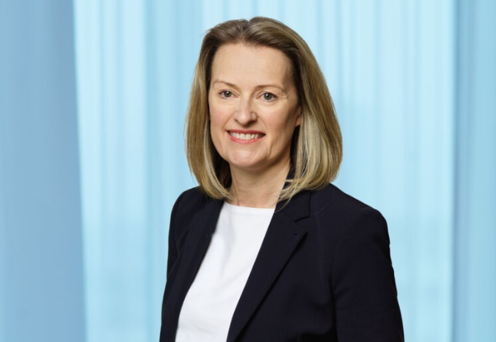
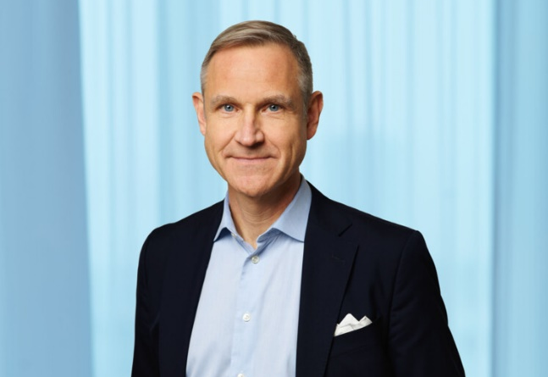
Executive Leadership (continued)
Stella Medlicott
Carl Mellander
Senior Vice President, Chief Marketing and Communications Officer and Head, Marketing & Corporate Relations
Senior Vice President, Chief Financial Officer and Head, Finance and Common Functions
Stella Medlicott was appointed Senior Vice President and Head of Group Function Marketing & Corporate Relations in June 2019. Previously, she held the position as Vice President, Marketing & Communications and Government & Industry Relations within Ericsson’s Market Area Europe and Latin America.
Medlicott joined Ericsson in 2014 following the acquisition of Red Bee Media where she held the position of Chief Marketing Officer. She has over 25 years marketing experience in major IT, telecoms and media companies.
Stella Medlicott has a BA (Hons) degree in Social Science and a Postgraduate Diploma in Marketing.
Carl Mellander is CFO of Ericsson since April 1, 2017. He was previously Acting CFO from July 2016 to March 2017. Prior to this role he held the positions as Head of Treasury (between 2015 and July 2016) and Head of Finance in Region Western and Central Europe (2010 – 2015).
Carl Mellander joined Ericsson the first time in in 1994. He left the company in 2003 and worked in different senior finance positions for Saab and Telecom Management Partner AS in Africa. He joined Ericsson again in 2007 as Head of Finance for Market Unit Northern Europe.
Mellander has held various positions in finance and business control through his career in Ericsson. He has lived and worked for Ericsson in UK, Germany, Costa Rica and the US, in addition to his positions at the Headquarters in Stockholm.
He holds a Bachelor of Business Administration and Economics from the University of Stockholm, Sweden.

Slide 18
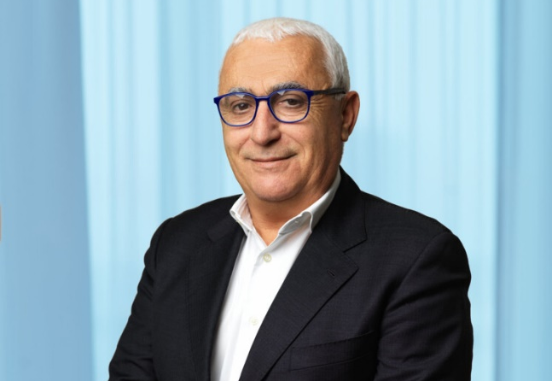
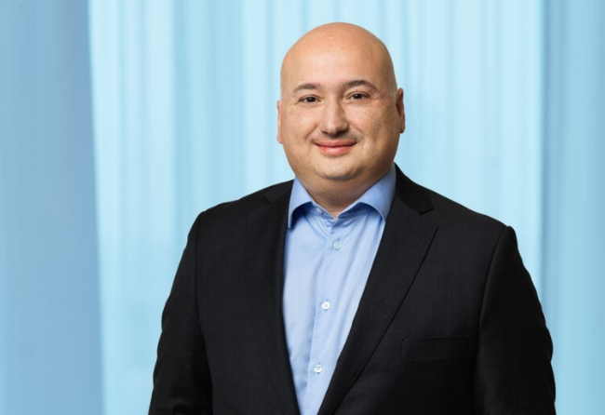
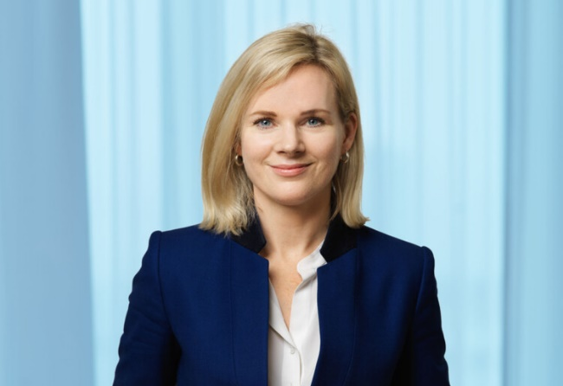
Executive Leadership (continued)
Nunzio Mirtillo
Fadi Pharaon
Åsa Tamsons
Senior Vice President and Head, South East Asia, Oceania & India
Senior Vice President and Head, Middle East & Africa
Senior Vice President, Head, Technologies & New Businesses and Head, Segment Emerging Business & Other
Nunzio Mirtillo is Head of Market Area South East Asia, Oceania and India. Before holding this position, Mirtillo served as Head of Region Mediterranean from 2010-2017, where he drove business growth and deepened customer relationships with operator customers.
He has held different management positions within Ericsson; for example, Head of Networks Sales for Western Europe 2006-2009. Prior to that, Mirtillo was Head of Business Operations in South East Europe where he promoted business growth for all business segments.
Mirtillo joined Ericsson in 1988, having started his career working in software development, network system engineering and solution architecture. He was part of the launch of the first GSM network in the early 1990s. Mirtillo has a Master in Electronic Engineering from Sapienza University, Italy.
Fadi Pharaon leads the Market Area Middle East & Africa, serving customers in the Middle East and Africa with Ericsson’s innovative technology and services. Throughout his career, he has demonstrated an ability to deliver customer value combined with a business development focus for creating new opportunities.
In his previous role as Vice President of Networks & Managed Services within Ericsson’s Market Area Europe and & Latin America, Pharaon focused on growing the infrastructure and services business across a large geography by providing clear and competitive value to customers.
With more than 21 years of experience at Ericsson, Fadi Pharaon has held several management positions with technical, sales and marketing responsibilities in markets across Asia, Europe, Middle East, and Latin America.
Pharaon holds a Master of Science in Computer Science from the Royal Institute of Technology in Stockholm, Sweden and a Master of Business Administration from Heriot Watt University, Edinburgh Business School, Scotland.
Åsa Tamsons is Senior Vice President and Head of Business Area Technologies and New Businesses and member of Ericsson’s Executive Team. With focus on technology and innovation, Tamsons team is responsible to drive growth in new areas for Ericsson. They do this by identifying, developing and scaling new businesses that support Ericsson’s customers to capture the full potential of 5G, IoT and future technologies.
Tamsons team drives the Ericsson IPR and licensing, Ericsson´s global IoT platform business, Global Dedicated Networks business and Small- Medium Business Solutions (SMB Solutions), and a number of other emerging businesses in incubation stage through the innovation hub Ericsson ONE.
Previous experience as partner at McKinsey & Company, where Tamsons has been serving tech, telecom and industrial companies around the world. Her expertise was focused on growth strategy and B2B sales and marketing.
Åsa Tamsons holds a Master of Science in Business Administration from Stockholm School of Economics.

Slide 19
Board Calendar

Slide 20
2021 Board Calendar
Date | Details
January 28th | Virtual
March 29th | Virtual; day before Annual General Meeting
April 20th | Virtual; Q1 reporting – finance focused
June 9th | Virtual;
July 15th | Virtual; Q2 reporting – finance focused
September 21st to 23rd | Multi-day in person meeting
October 21st | Virtual; Q3 reporting – finance focused
December 14-17th | To be confirmed – in person meeting

Slide 21
Director Compensation

Slide 22
Director Compensation
In accordance with the proposal of the Nomination Committee, the Annual General Meeting of shareholders resolved on March 31, 2020, that the fees to non-employee Board members and to non-employee members of the Committees of the Board elected by the Meeting, be paid as follows:
the Chairman of the Board - SEK 4,075,000
the other Board members - SEK 1,020,000 each
the Chairman of the Audit and Compliance Committee - SEK 400,000
the Audit Compliance Committee members - SEK 250,000
the Chairman of the Finance Committee, the Remuneration Committee and the Technology and Science Committee - SEK 200,000 each
the Finance Committee, the Remuneration Committee and the Technology and Science Committee members - SEK 175,000 each

